Slide 1

Programming for Data Analytics Project
Tareq Haboukh

Slide 2
AdventureWorks.xlsx
The file has 4 sheets
Product
SalesOrderDetails
SalesOrderHeader
SalesTerritory
For this project we only need to import SalesOrderHeader and SalesTerritory using proc import

Slide 3
Phase 1
Importing the data

Slide 4
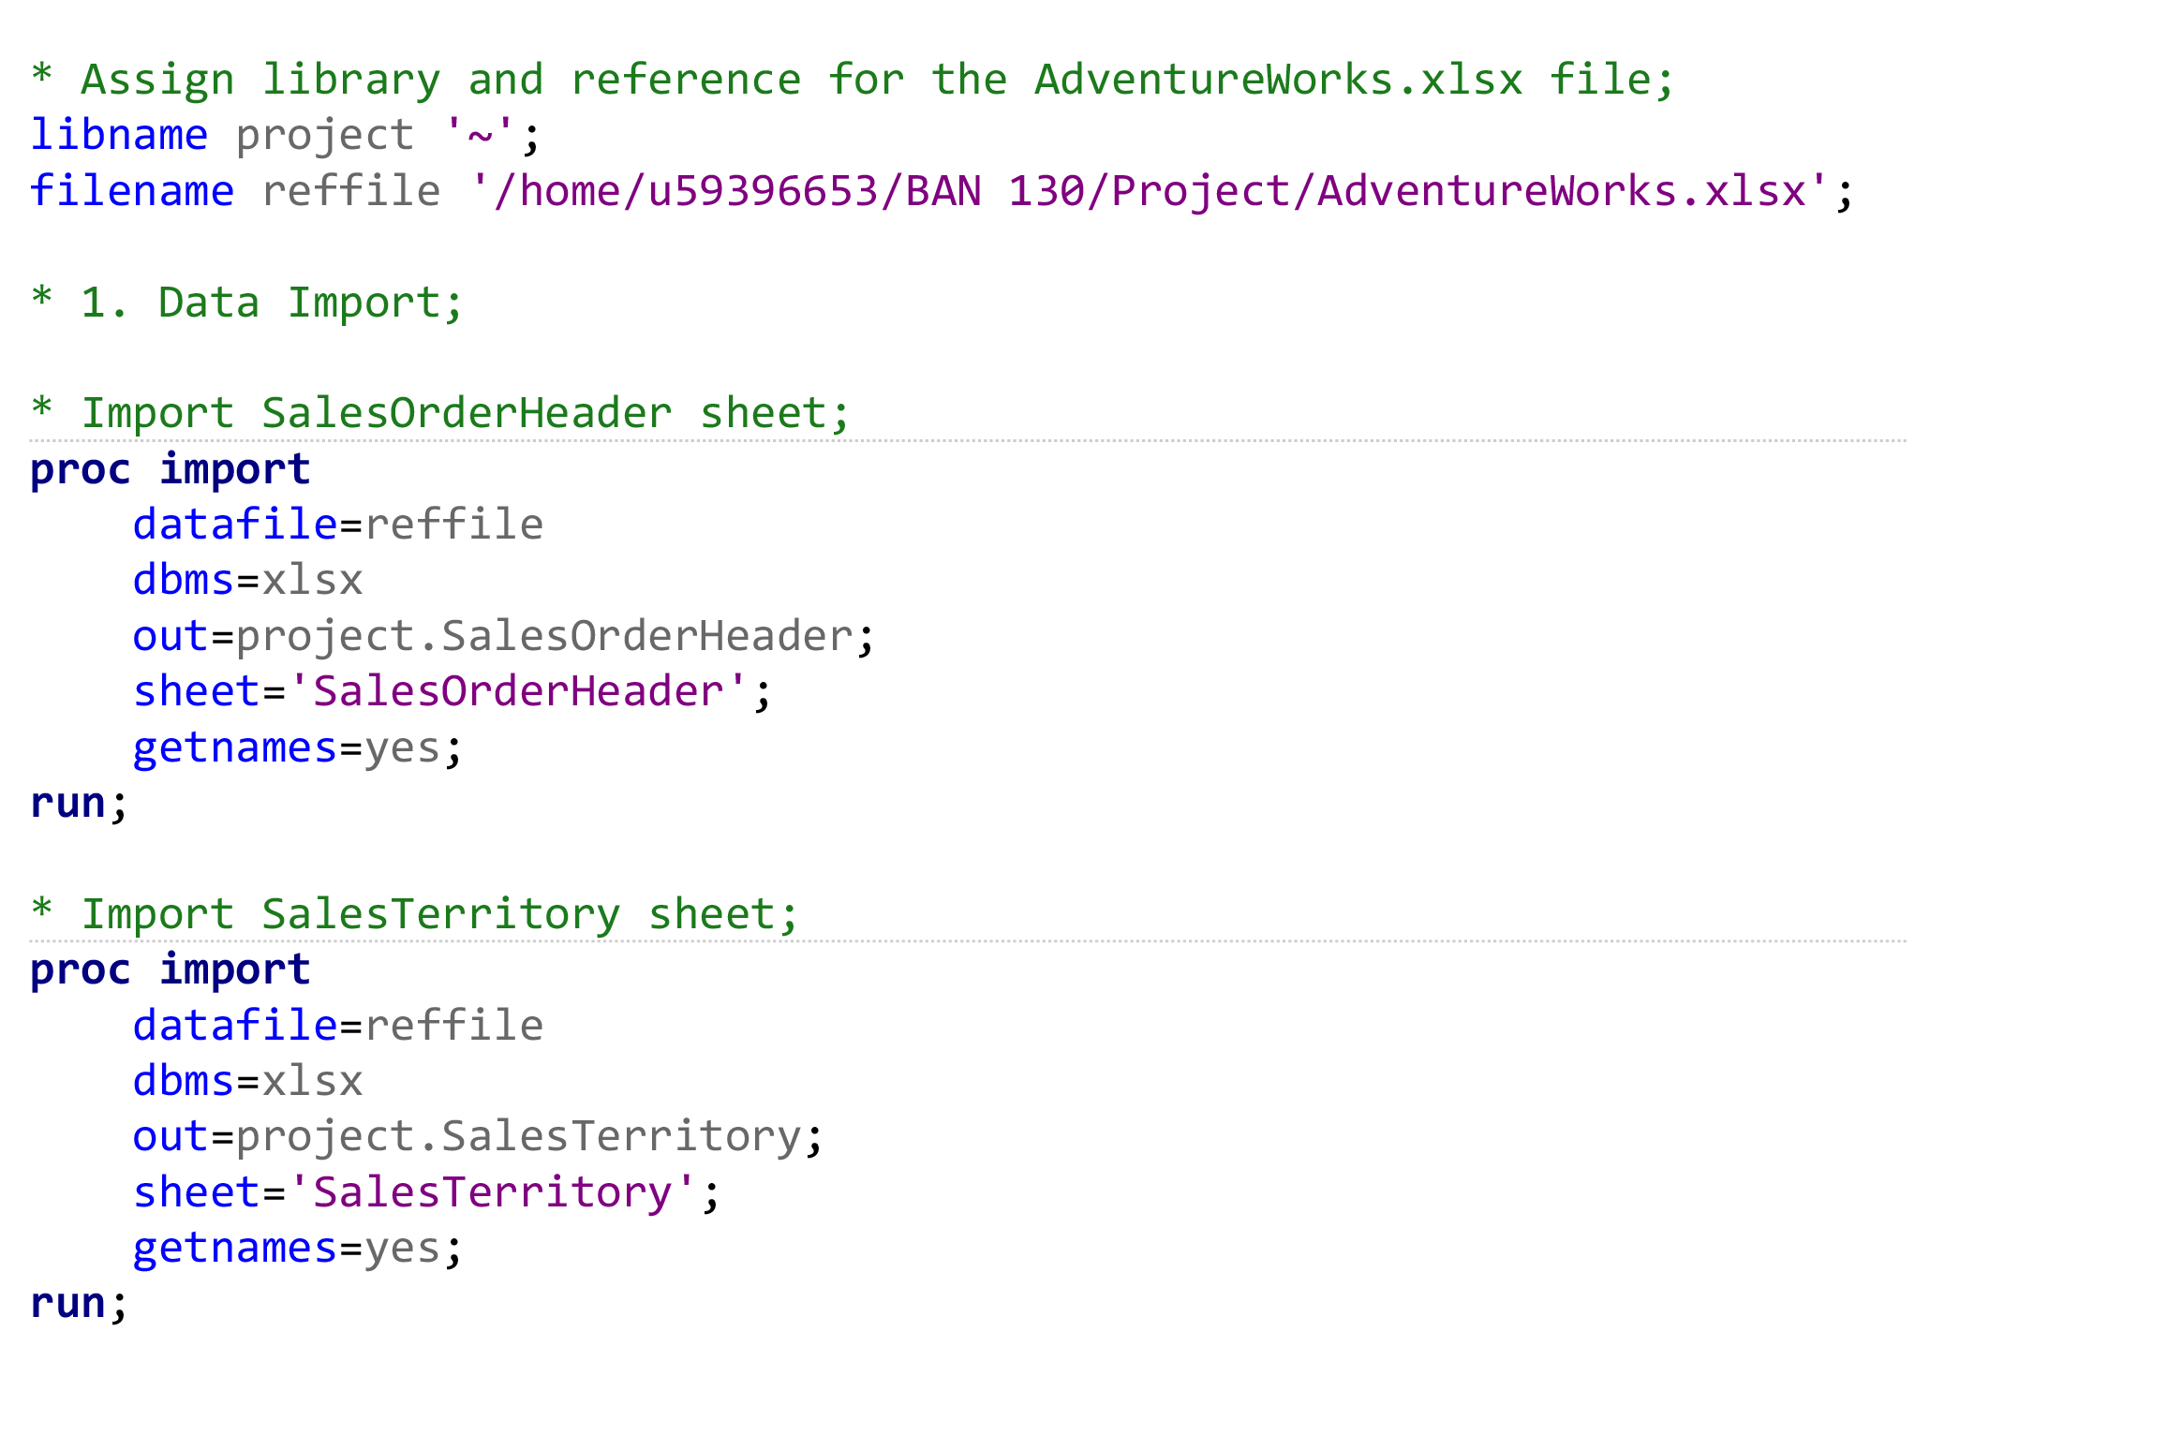
Importing The Data

Slide 5
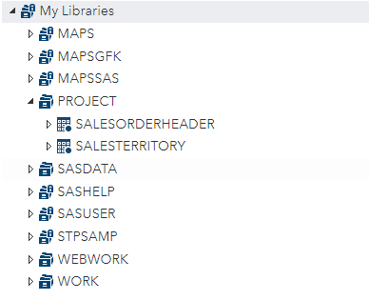
Importing The Data
This created two new datasets in the project library

Slide 6
Phase 2
Cleaning the data

Slide 7
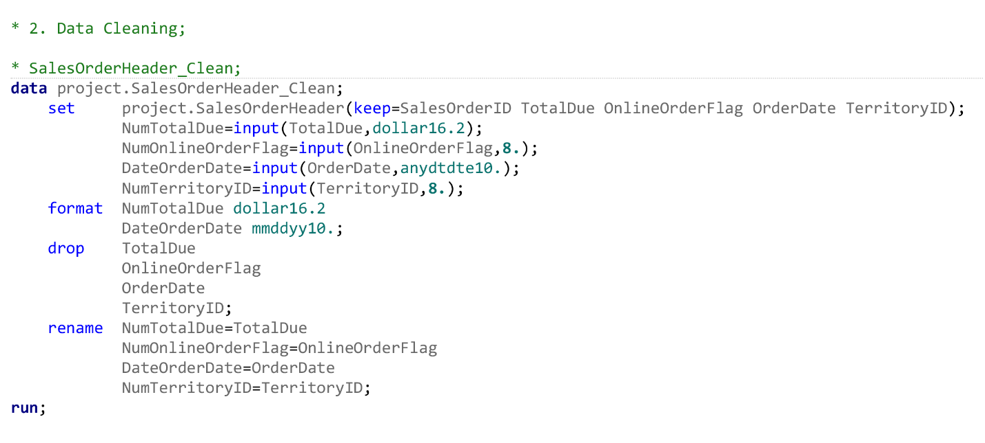
SalesOrderHeader_Clean

Slide 8
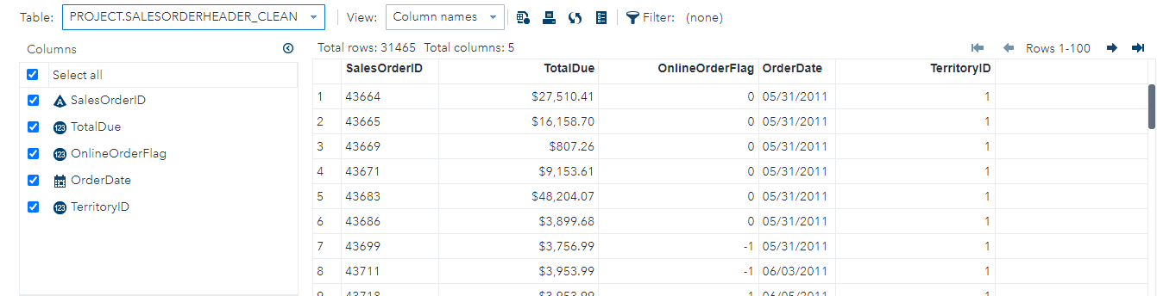
SalesOrderHeader_Clean

Slide 9
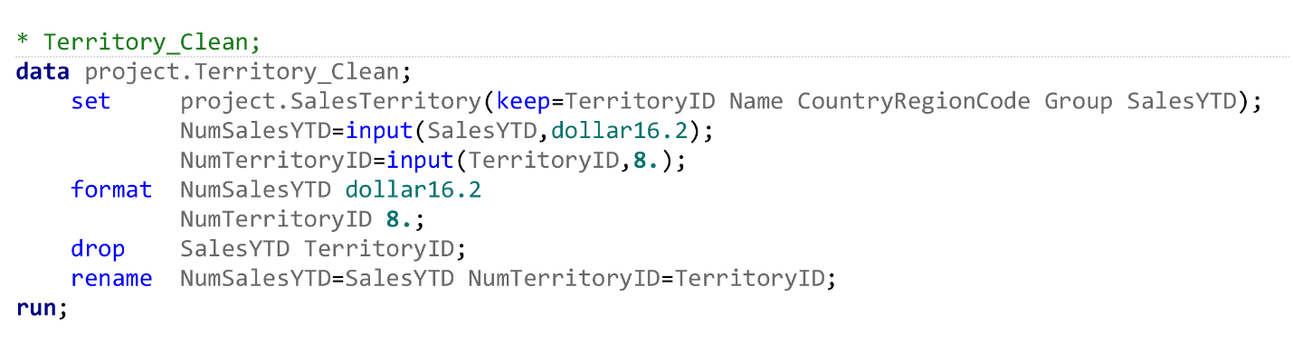
Territory_Clean

Slide 10
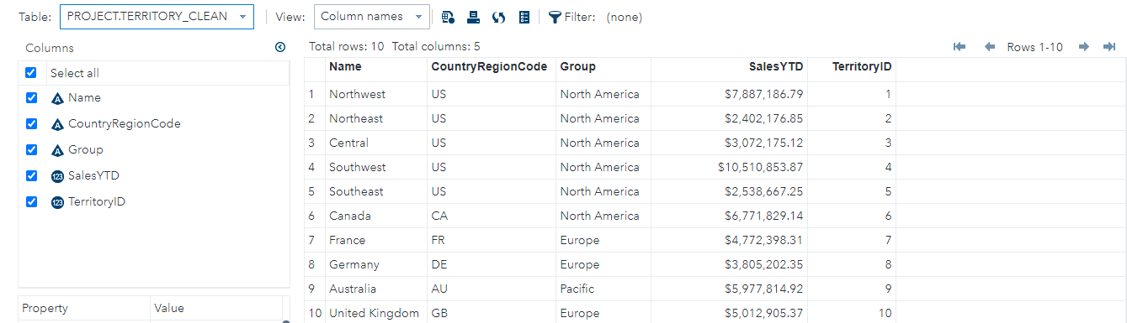
Territory_Clean

Slide 11
Phase 3
Joining & Merging

Slide 12
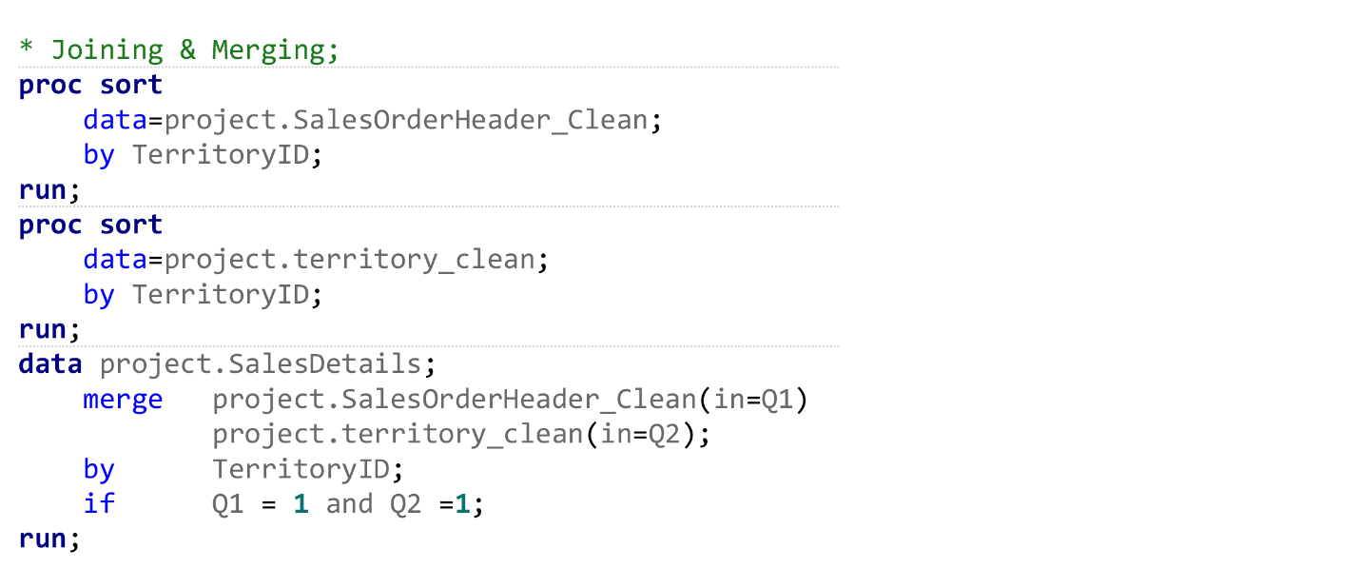
Joining & Merging

Slide 13
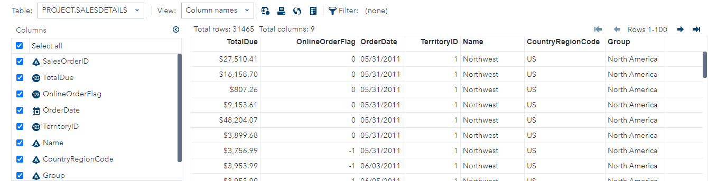
SalesDetails

Slide 14
Phase 3
Analysis Dataset

Slide 15
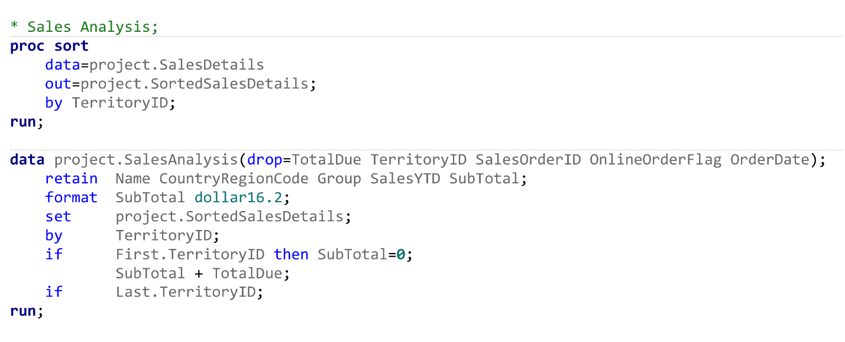
SalesAnalysis

Slide 16
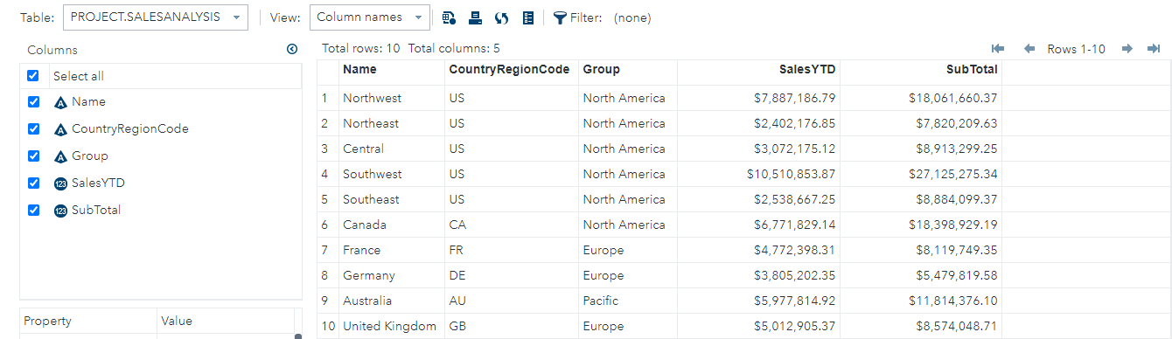
SalesAnalysis

Slide 17
Phase 4
Answering 5 Question

Slide 18
Answering 5 Question
What is the Total Due for all the North American Regions?
What is the total Sales YTD for U.S.?
How much is due from France and Germany?
What is the total Sales YTD for Europe?
How many total territories in U.S?

Slide 19
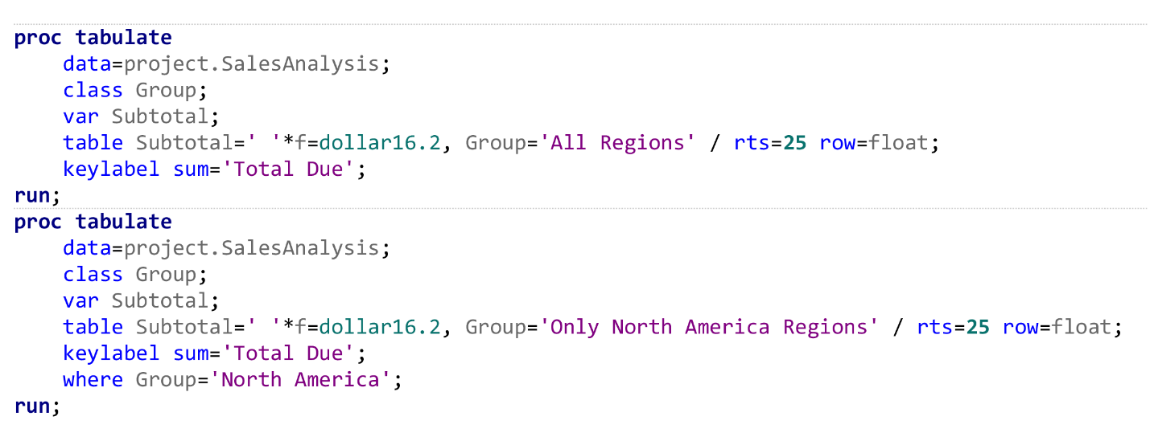
What is the Total Due for all the North American Regions?

Slide 20
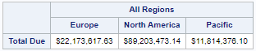
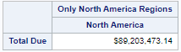
What is the Total Due for all the North American Regions?

Slide 21
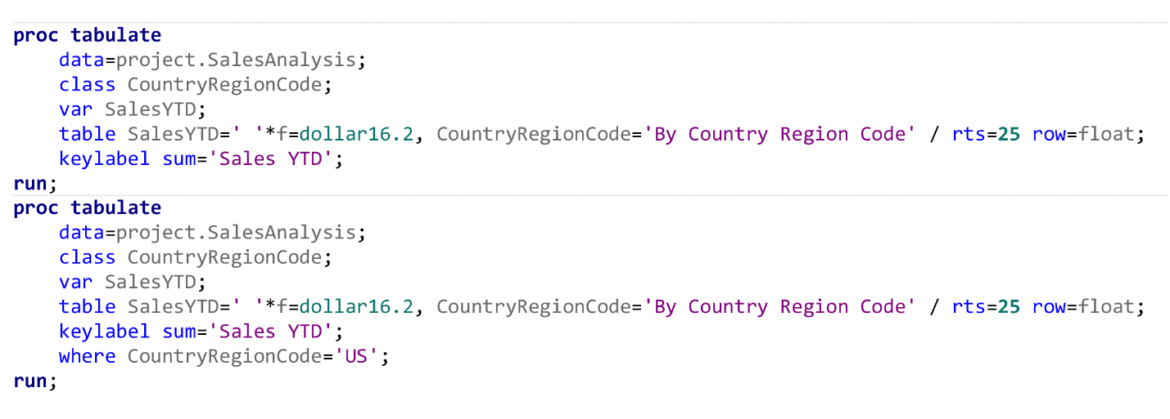
What is the total Sales YTD for U.S.?

Slide 22
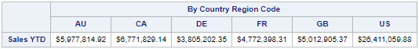
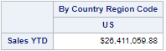
What is the total Sales YTD for U.S.?

Slide 23
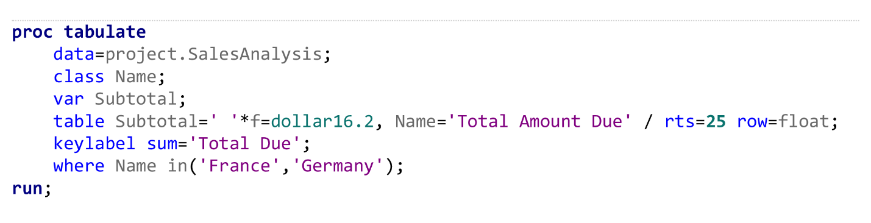
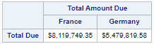
How much is due from France and Germany?

Slide 24
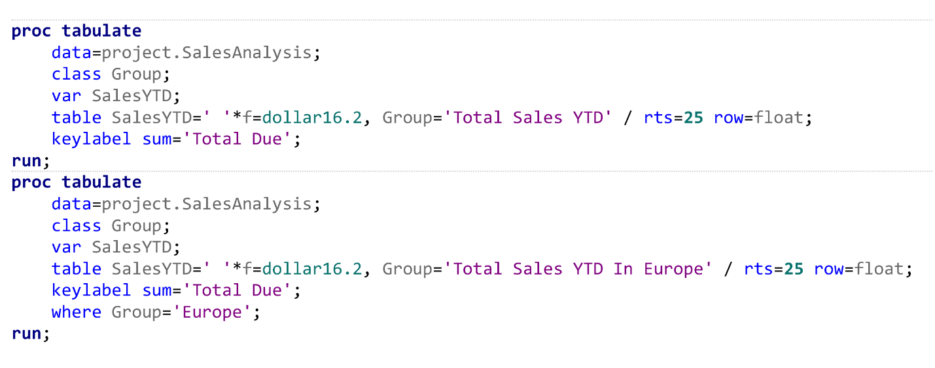
What is the total Sales YTD for Europe?

Slide 25
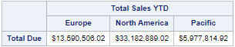
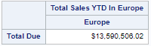
What is the total Sales YTD for Europe?

Slide 26
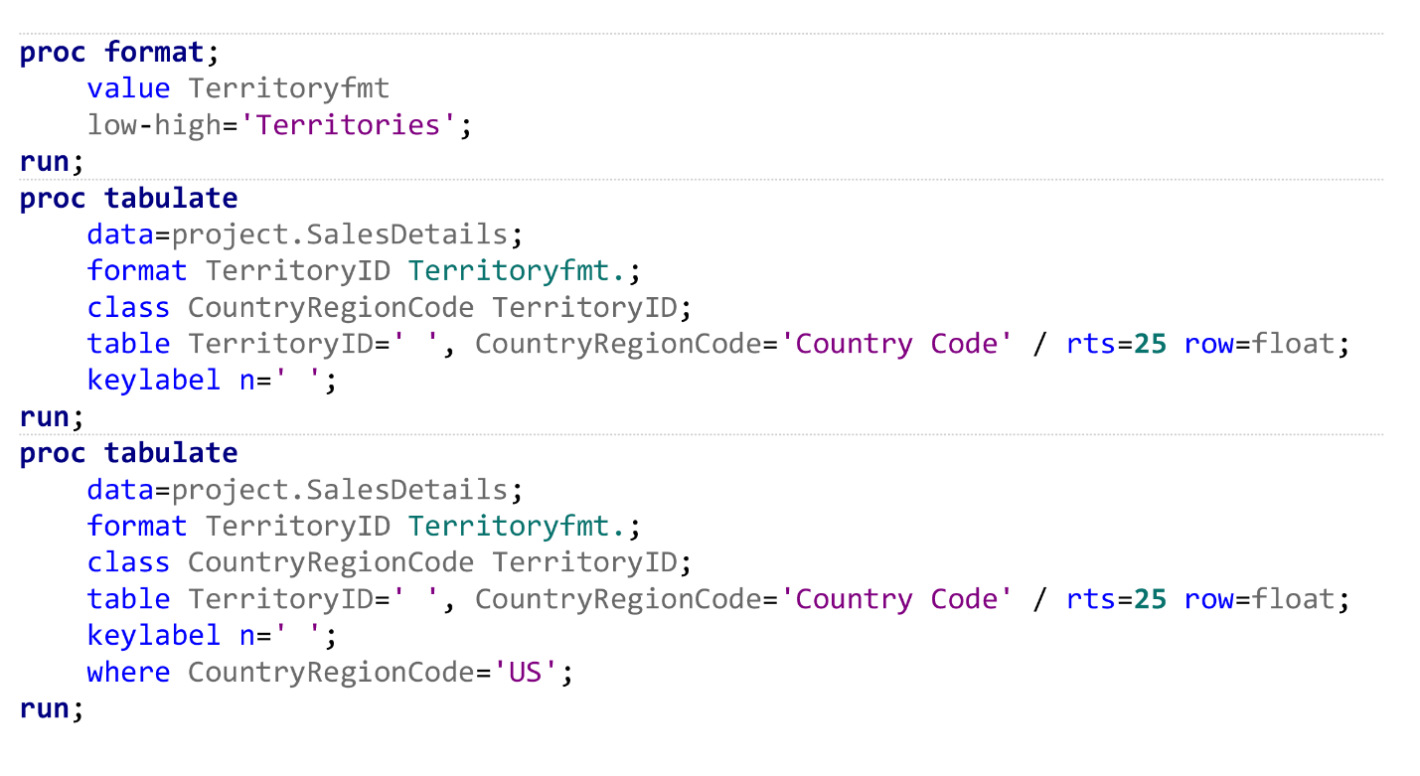
How many total territories in U.S?

Slide 27
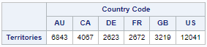
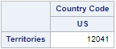
How many total territories in U.S?

Slide 28
Phase 4
Create at least one chart

Slide 29
Graphs to show
Total Amount Due By Country
Total Amount Due & Percentage for the US Region

Slide 30
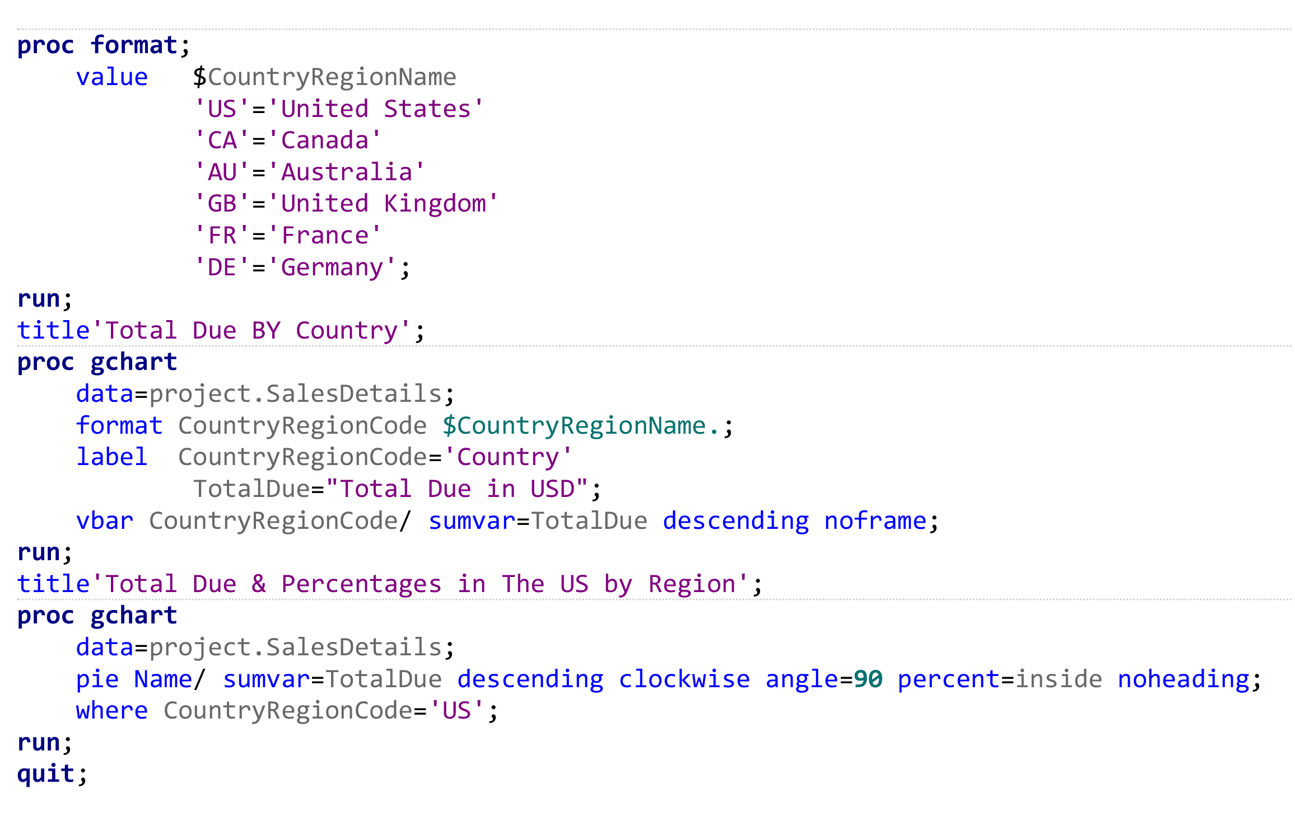
Total Due By Country

Slide 31
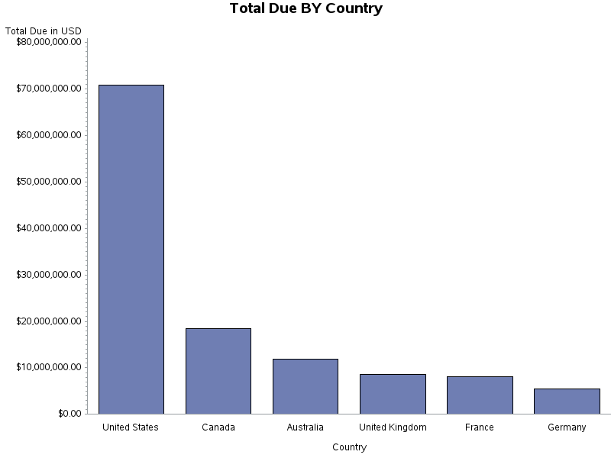
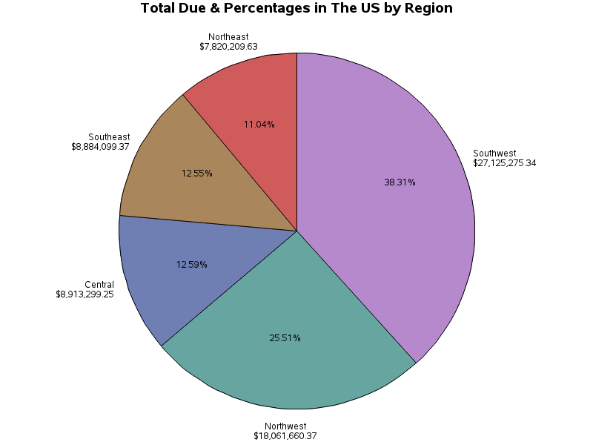

Slide 32
Thank you

